Slide 1
DSC530 – Data exploration and analysis final
Brandon Wyche

Slide 2
Question & Hypothesis
Problem
“What is the relationship between employee satisfaction and productivity?”
Null Hypothesis
Employee productivity does not depend on employee satisfaction.
Alternate Hypotheses
Employee productivity depends on employee satisfaction.

Slide 3
DataSET BREAKDOWN
Employee Productivity and Satisfaction (HR Data)
- Projects Completed: Number of projects completed per employee (out of 25)
- Productivity (%): Percentage of time spent working on assigned deliverables (out of 100)
- Satisfaction Rate (%): Employee stated scale of satisfaction (out of 100)
- Feedback Score: Feedback received from manager (out of 5)
- Salary: Paid annual salary (in USD)

Slide 4
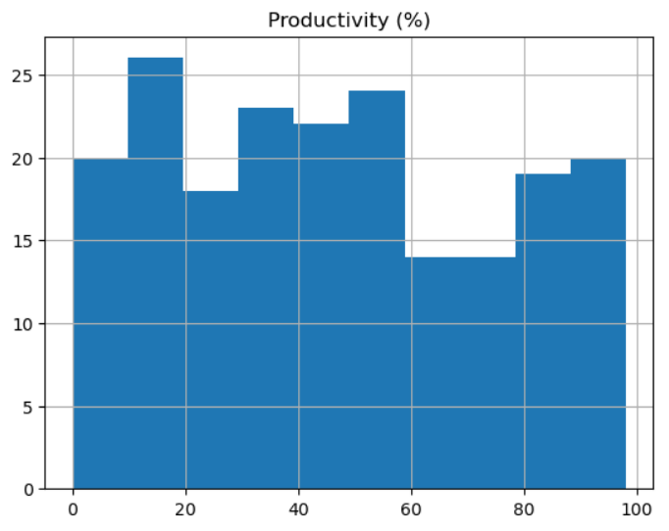
Histogram: productivity

Slide 5
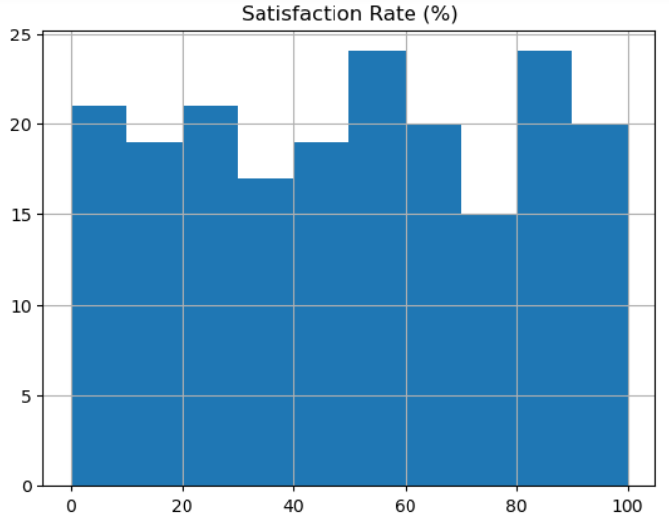
Histogram: Satisfaction rate

Slide 6
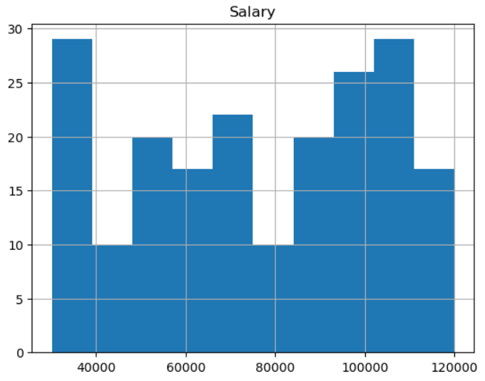
Histogram: Salary
Many individuals whose salaries are less than $40000.
While not an outlier, it is worth noting due to how it warps the distribution of salaries. This is likely due to the overwhelming availability of entry level jobs, and won’t be omitted from the data set.

Slide 7
Histogram: productivity

Slide 8
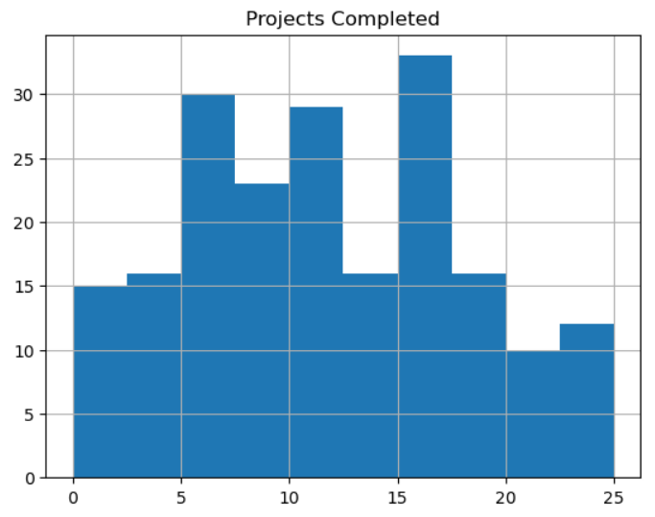
Histogram: Projects completed

Slide 9
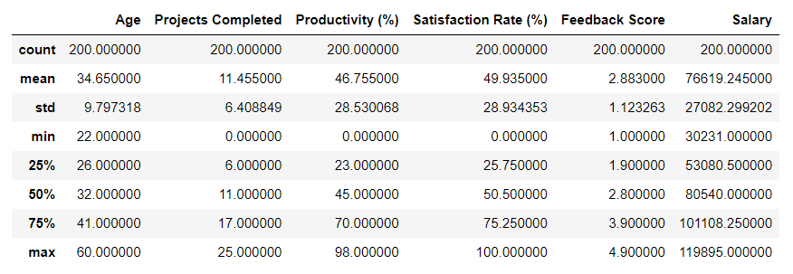
Descriptive analysis

Slide 10
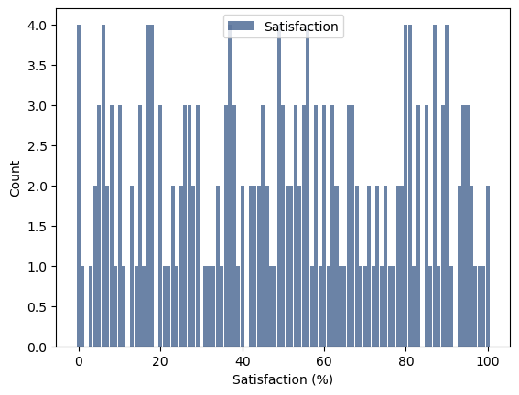
Probability mass function

Slide 11
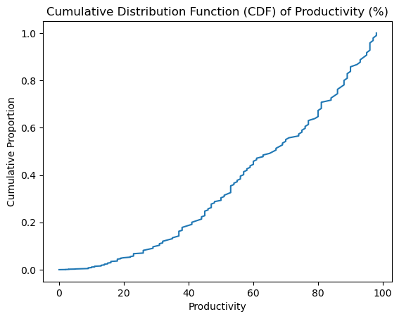
Cumulative distribution function
We can see from this figure that there is lower productivity with a lower CDF

Slide 12
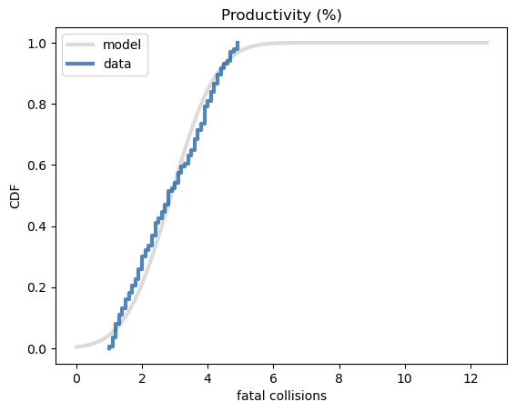
Normal probability plot
(productivity)
The normal probability plot of productivity shows that there isn’t a substantiative departure from the normal probability distribution and falls in a straight line.

Slide 13
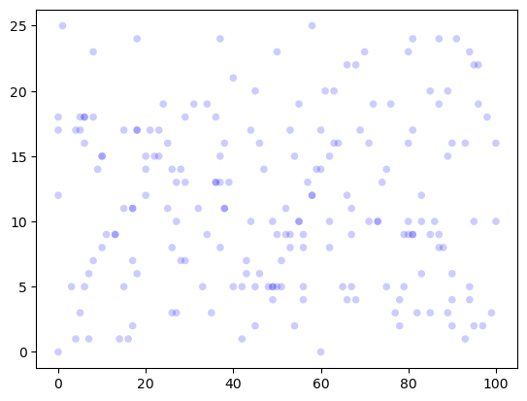
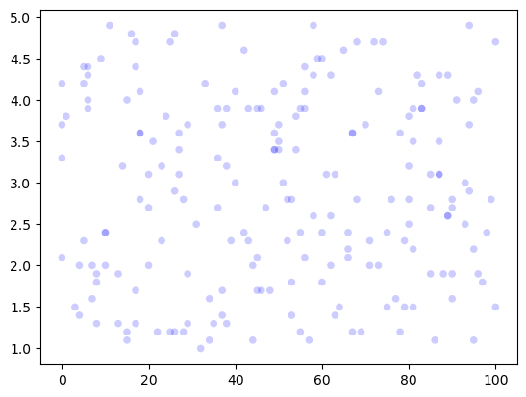
Scatter plots
Projects Completed (p) & Satisfaction (s)
Feedback Score (f) & Satisfaction (s)
Both Feedback Score and Projects Completed are indirect variables effected by overall productivity.
Seeing any correlation between the two and employee satisfaction may imply a relationship
Both variables share a correlation close to 0 with satisfaction, showing next to no correlation
p
f
S
Correlation: -0.010
S
Correlation: 0.008

Slide 14
Hypothesis Test
Calculating the P-Value of satisfaction and productivity via Permutation Test yielded a value of 0.281
If we subtract the P-Value from 1, we have a probability of 0.719 that our Alternate Hypothesis is true

Slide 15
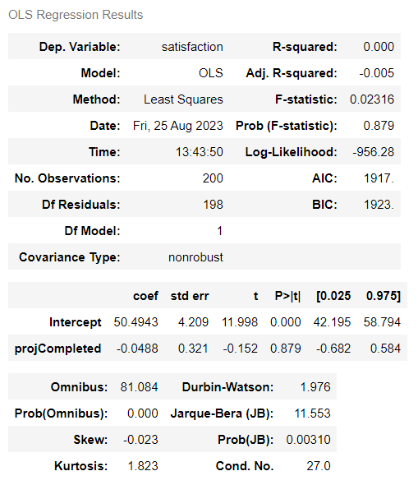
Regression analysis

